Slide 1


Elevate Your Workout, Elevate Your Life

Slide 2
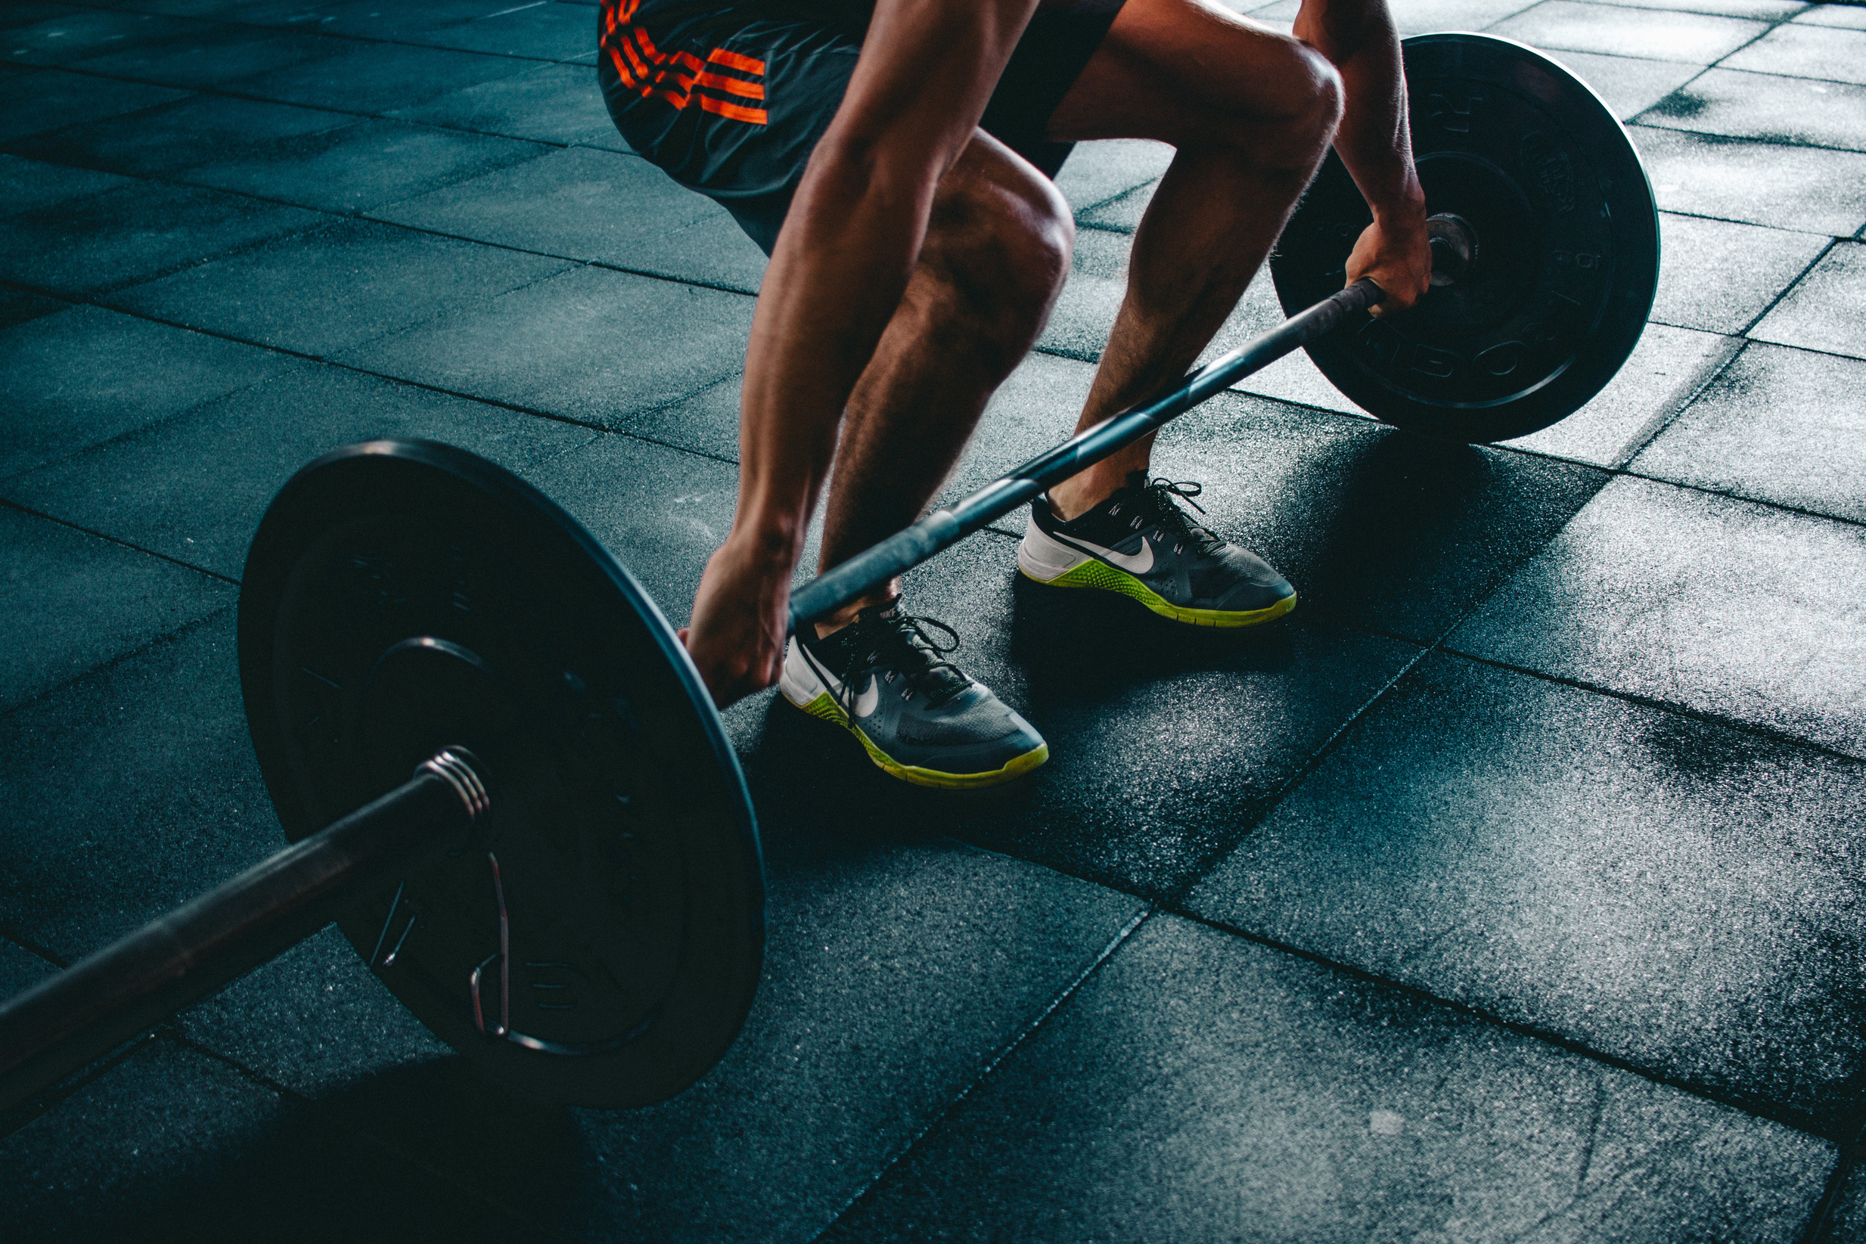

Empowering Health & Fitness: Building a Holistic Fitness App
Addressing Unique Health Needs for Men and Women
Promoting Diversity in Fitness and User-Friendliness
Increasing Interest in Women's Health

Slide 3


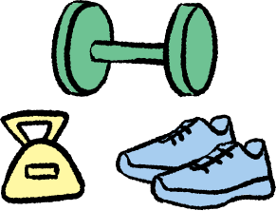
Trends
Women make up 75% of the fitness industry (Exercise.com)
Convenience & Accessibilty
Privacy and Comfort
Customisation and Personalisation
Women are more likely to consider themselves as being unhealthy (26%) vs men (21%).
(PureGym)
+
A.I

Slide 4
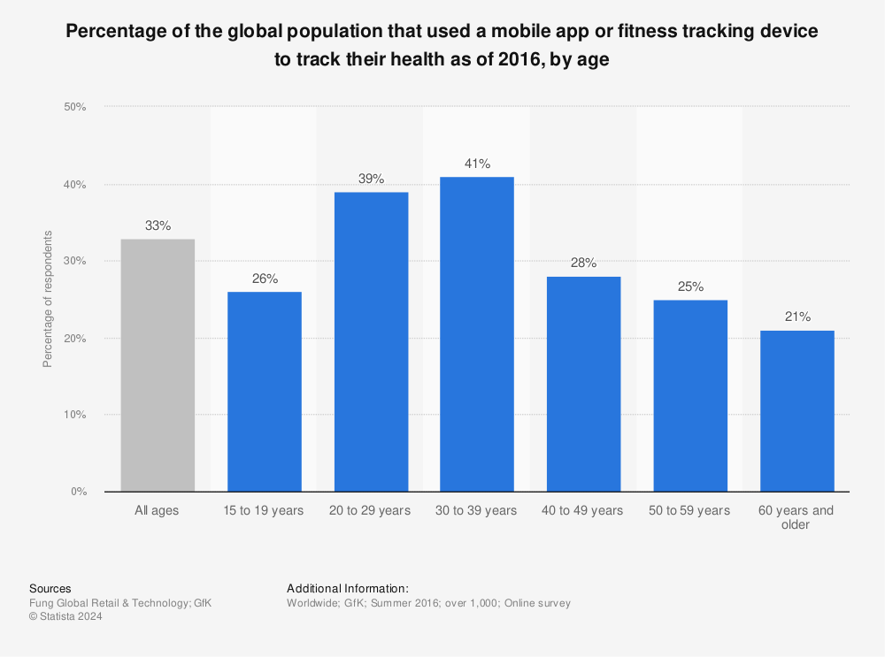

Trends
“People are turning to fitness apps as a convenient solution to track their workouts, set goals, and access personalised training programs.” (Statista)
Lack Of Motivation
Time Constraints
Boredom
“Two in five people (41%) say they are simply too tired after work to exercise, while a third (34%) say their job doesn’t leave them enough time to exercise. “ (PureGym)
66% of people in the UK say they don’t look after their health as much as they should (+1% since last year) (PureGym)

Slide 5


Main Features
Filtering Functionality
Large Exercise Database
Preference Analysis
AI algorithm
Descriptive Information

Slide 6


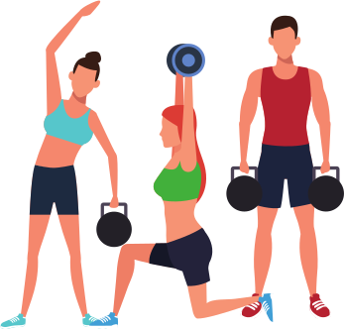


Other Features
Our goal is to offer you the benefits of working out while creating great experience
Fitness Reminders
Female-Oriented Exercises
Reminders when closing the website
Adapt to the market by providing excercises tailored to female users
Account system
Create account and allows users to rate an exercise by their own
Educational Resources
Educational resources blogs on topics such as nutrition, mental health

Slide 7
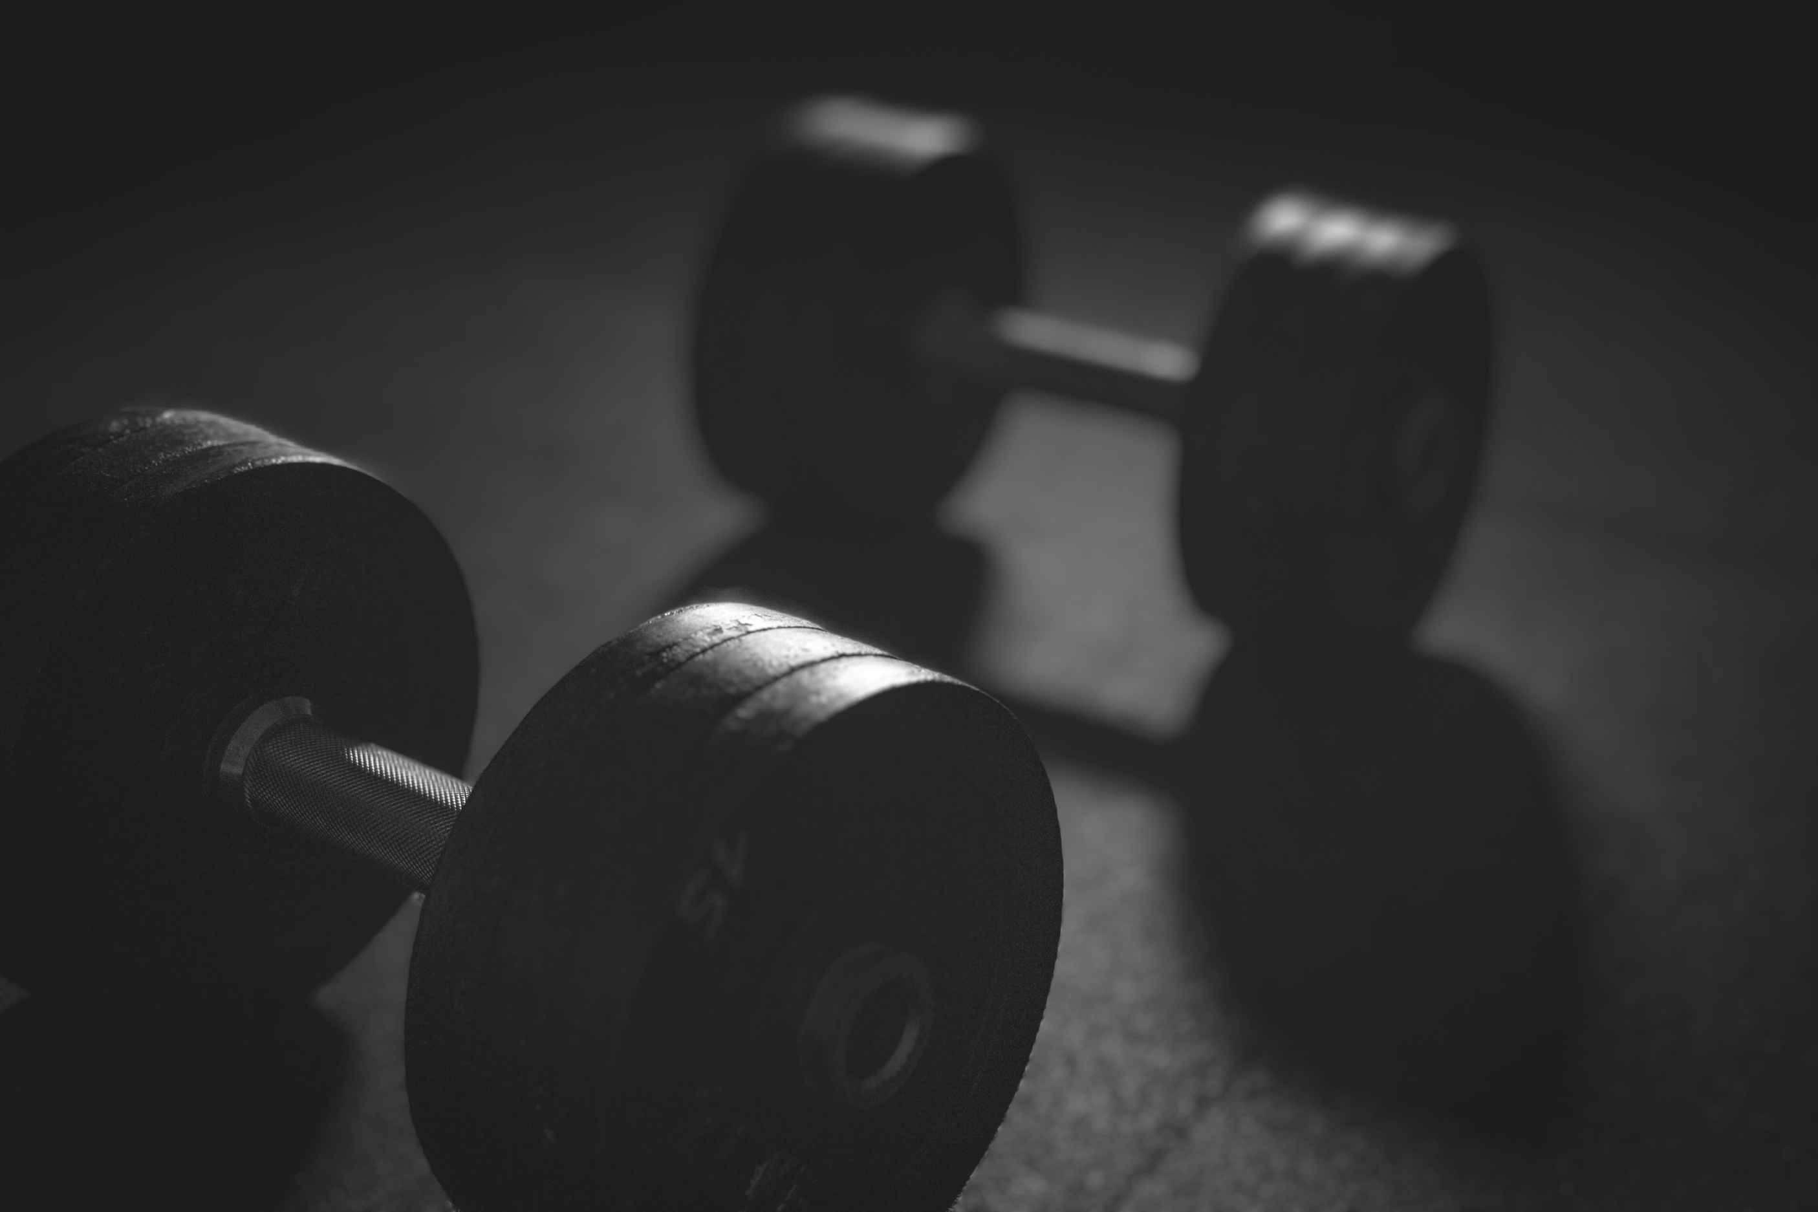
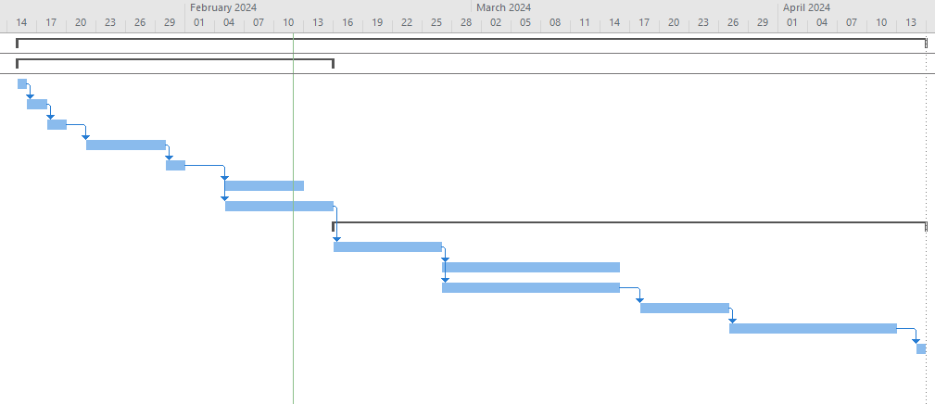
Preliminary project schedule.​

Slide 8
Technologies used​
FrontEnd: Html, CSS and JavaScript​
BackEnd: Maria DB​ and PHP
AI: Python (Pandas and Scikit-learn)

Slide 9
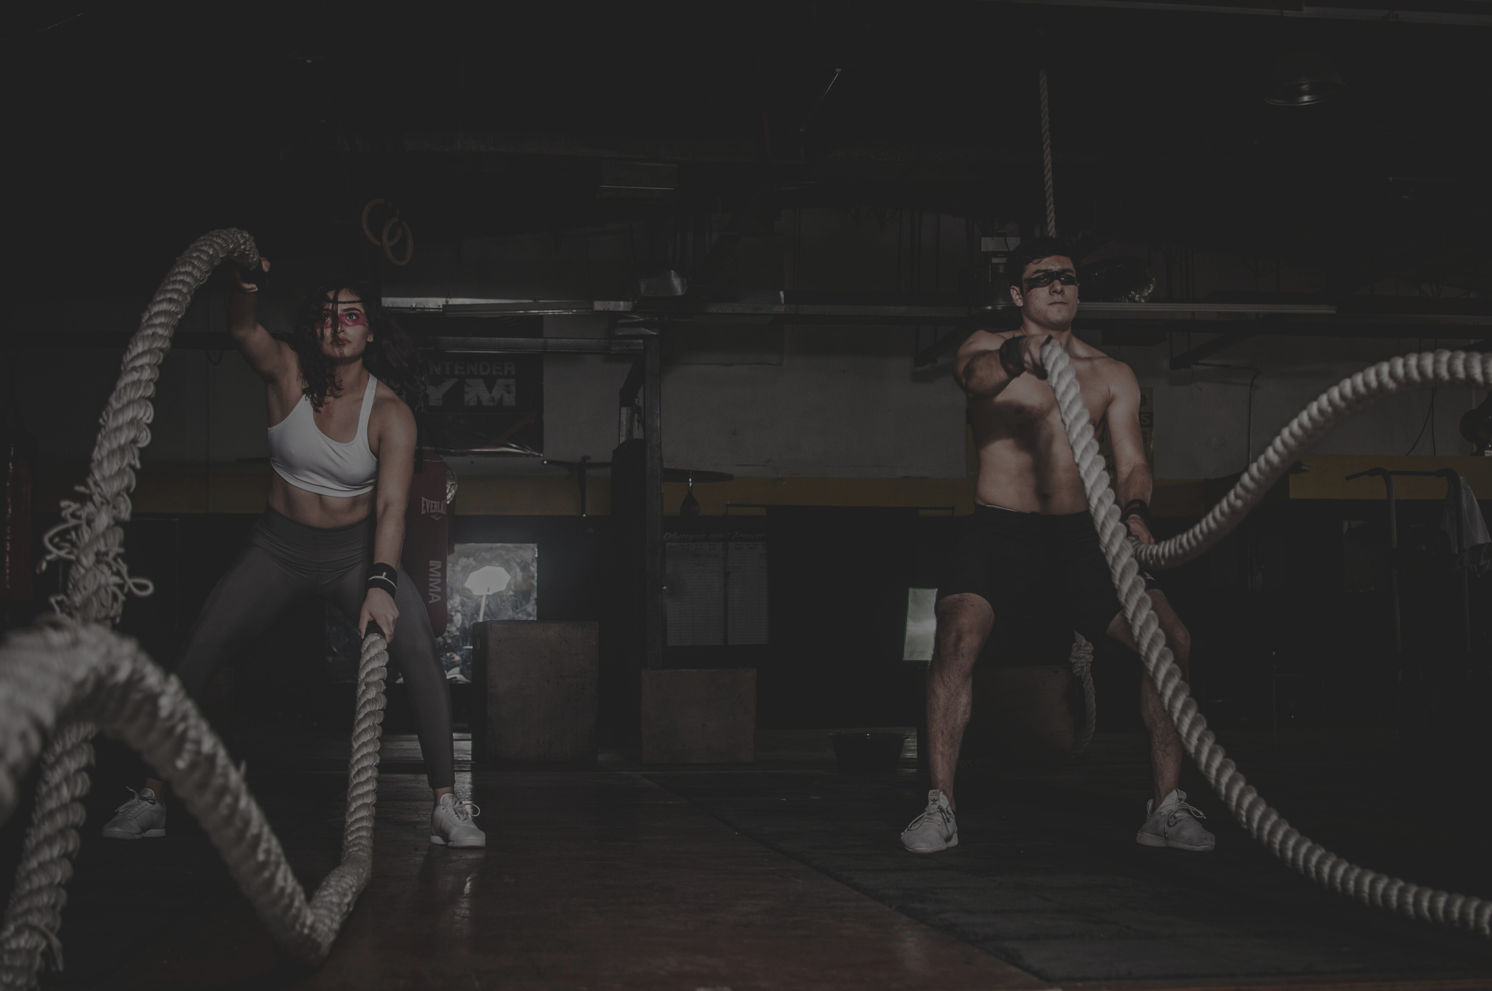

Project Management
Team Roles
Frontend
Backend
AI Model
Fanik & Sulaiman
Muiz & Tyler
Tom
User Interface
Web Server Development
Pre-proccess Dataset
Front End Scripts
Backend Scripts
Developing Algorithm
HTML, PHP, CSS, JS
Python, PHP and SQL
Python Development

Slide 10

Project Management
Colaboration Tools
MS Teams
Trello
VS Code + Github
General Comms
Task Management
Synced Dev Environment
Team Meetings
Check Member Progress
Version Control
Instant Messaging between members
Issue Tracker
Code Reviews

Slide 11

THANK YOU!

Slide 12
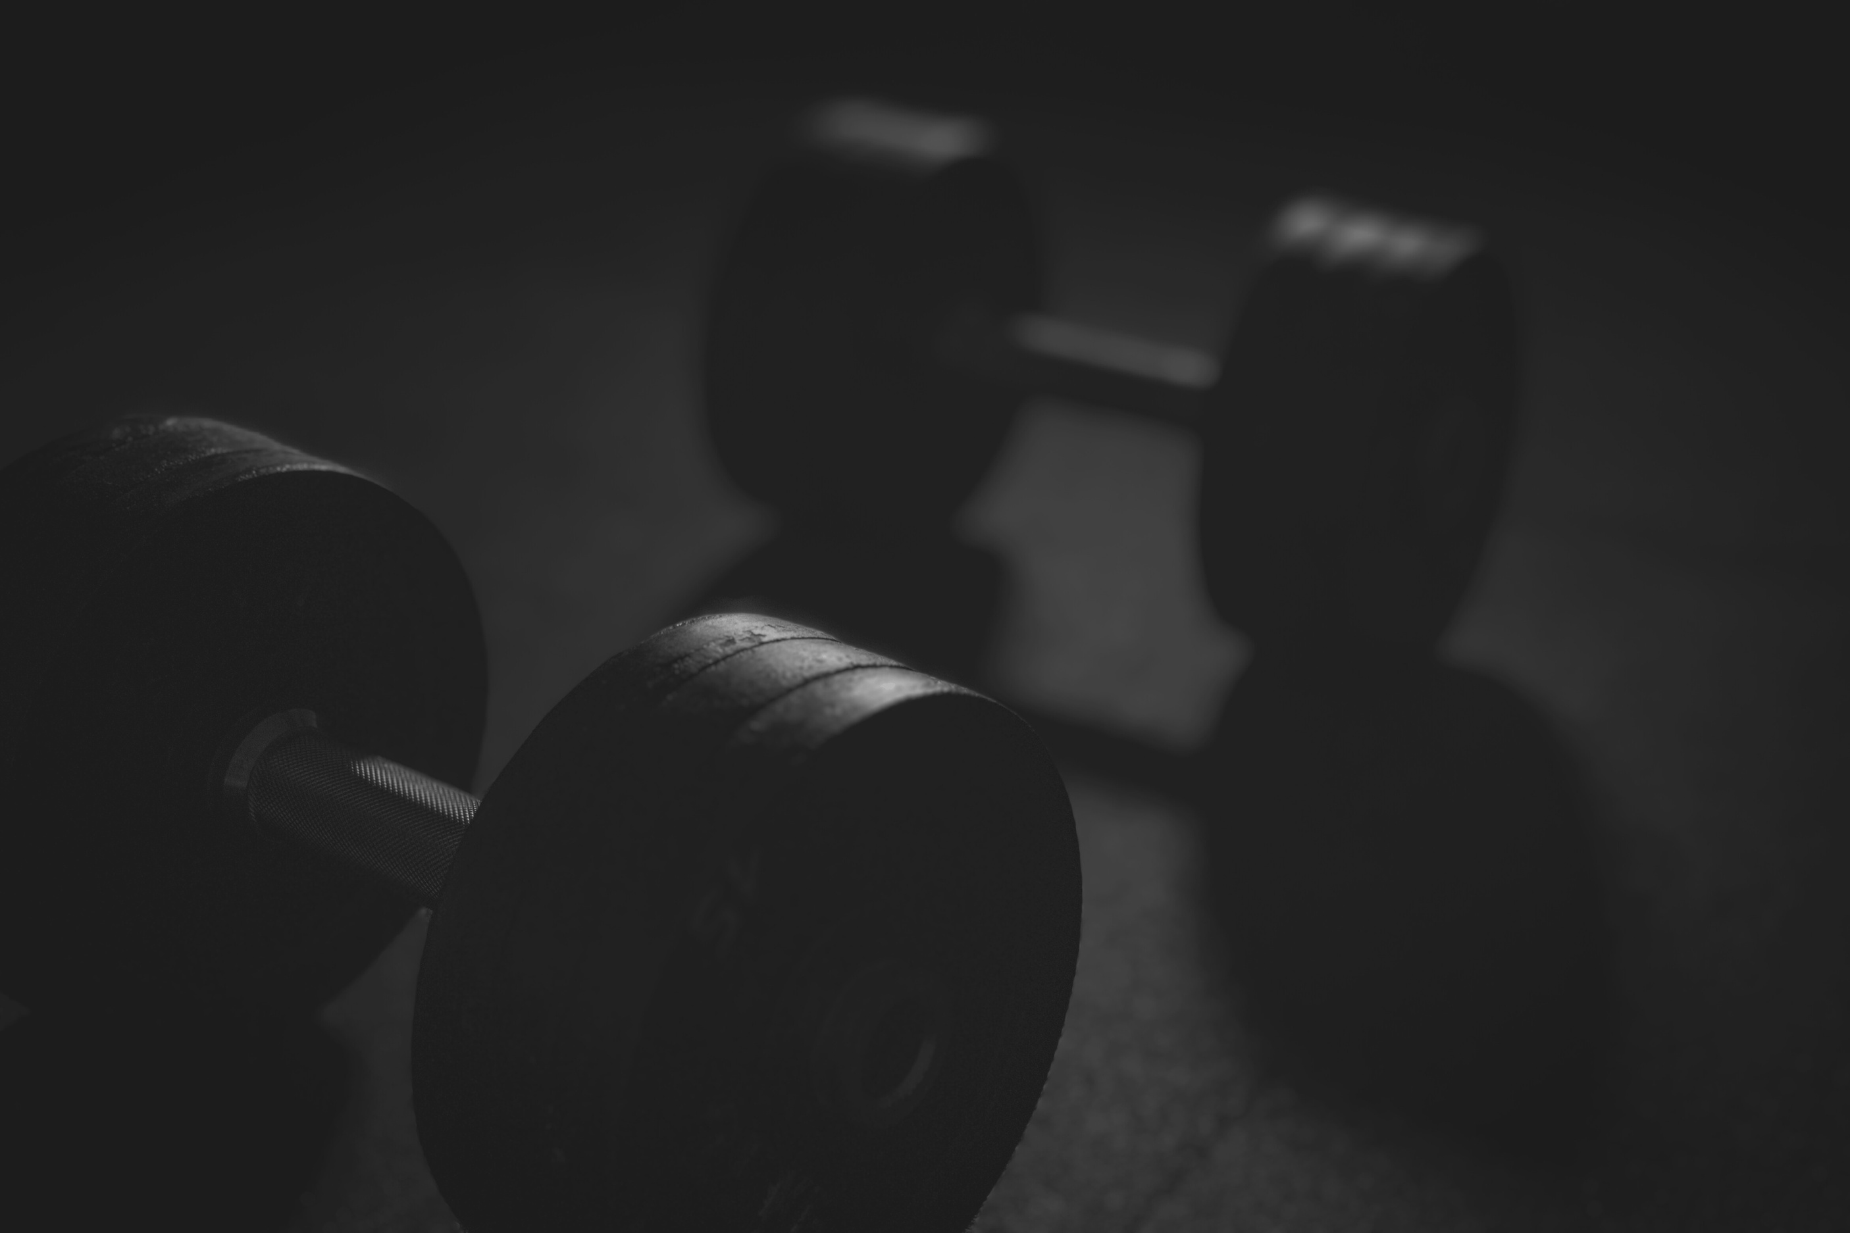
REFERENCES
Database: ​​Pandit, N. (n.d.). Gym Exercise Dataset. Retrieved from Kaggle: https://www.kaggle.com/datasets/niharika41298/gym-exercise-data
Ganapathy, A. (2015). AI Fitness Checks, Maintenance and Monitoring on Systems Managing Content & Data: A Study on CMS World. Malaysian Journal of Medical and Biological Research, 2(2), 113-118.
Huang, J., Kaewunruen, S., & Ning, J. (2022). AI-based quantification of fitness activities using smartphones. Sustainability, 14(2), 690.

